Slide 1
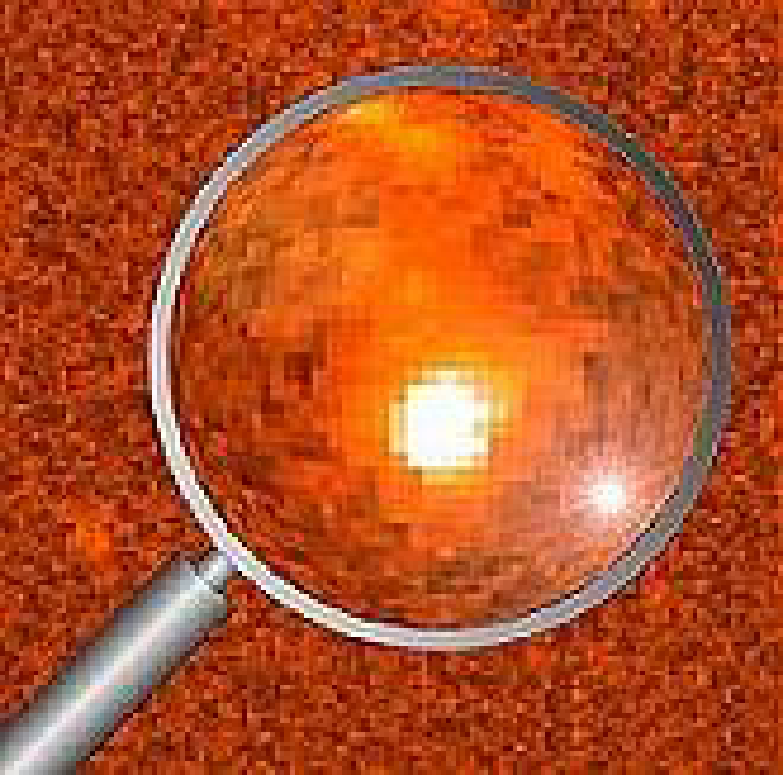
E/PO Program
GOAL: We will utilize the observations and scientific discoveries of the Swift mission to improve the understanding and utilization of science and mathematics concepts for grades 7-12.
E/PO team is actively promoting Swift gamma-ray burst science and discovery
Swift E/PO program is currently being rescoped to meet newly-defined NASA education implementation plan

Slide 2
E/PO Program
Web-based materials
Space Mysteries
Swift Web Site
Printed materials
GEMS guide (Lawrence Hall of Science)
Teacher’s activity booklets and posters
Educator training
New teacher’s workshops yearly at NSTA, NCTM, etc.
Swift exhibit booth for educator conferences
Appalachian Region Project (PSU)

Slide 3
E/PO Program
Informal Education
What’s in the News? (PSU)
NASA Quest Space Scientists Online Web Chats
Evaluation and Assessment
Space Mysteries has team of high school teachers for front-end assessment
GEMS does own assessment
Formative and summative evaluation of entire program will be performed by professional evaluators
Swift Education Committee will advise and monitor

Slide 4
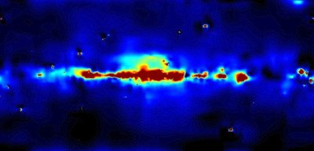
“Space Mysteries”
Funded by NASA Learners grant to SSU for 3 modules (to be released during 2001 - 2002)
Swift module planned for 2003 release
Two modules proposed for GLAST (2004-2005)

Slide 5
Space Mysteries Overview
Teach Physical Science & Mathematics
Inquiry-driven
Use the Web in a “videogame” adventure
Interaction, Innovation, Internet
Use real satellite data, interviews with real scientists, real analysis techniques
Involvement by Science Team in video segments

Slide 6

Sample Space Mystery Scenario
The Big Blast
A deep space traveler awakes from the flight-freezer when long-range sensors sound the alert of a dangerous environment. You must discover what is happening and what course of action to take.

Slide 7


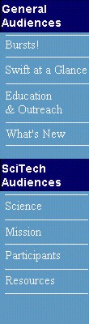

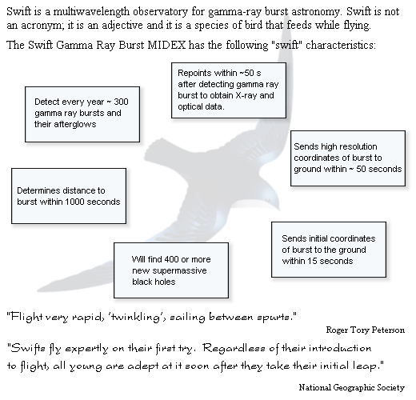
animation
http://swift.sonoma.edu/
10-7R

Slide 8

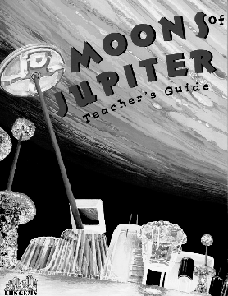
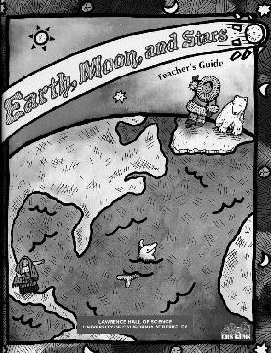

Slide 9
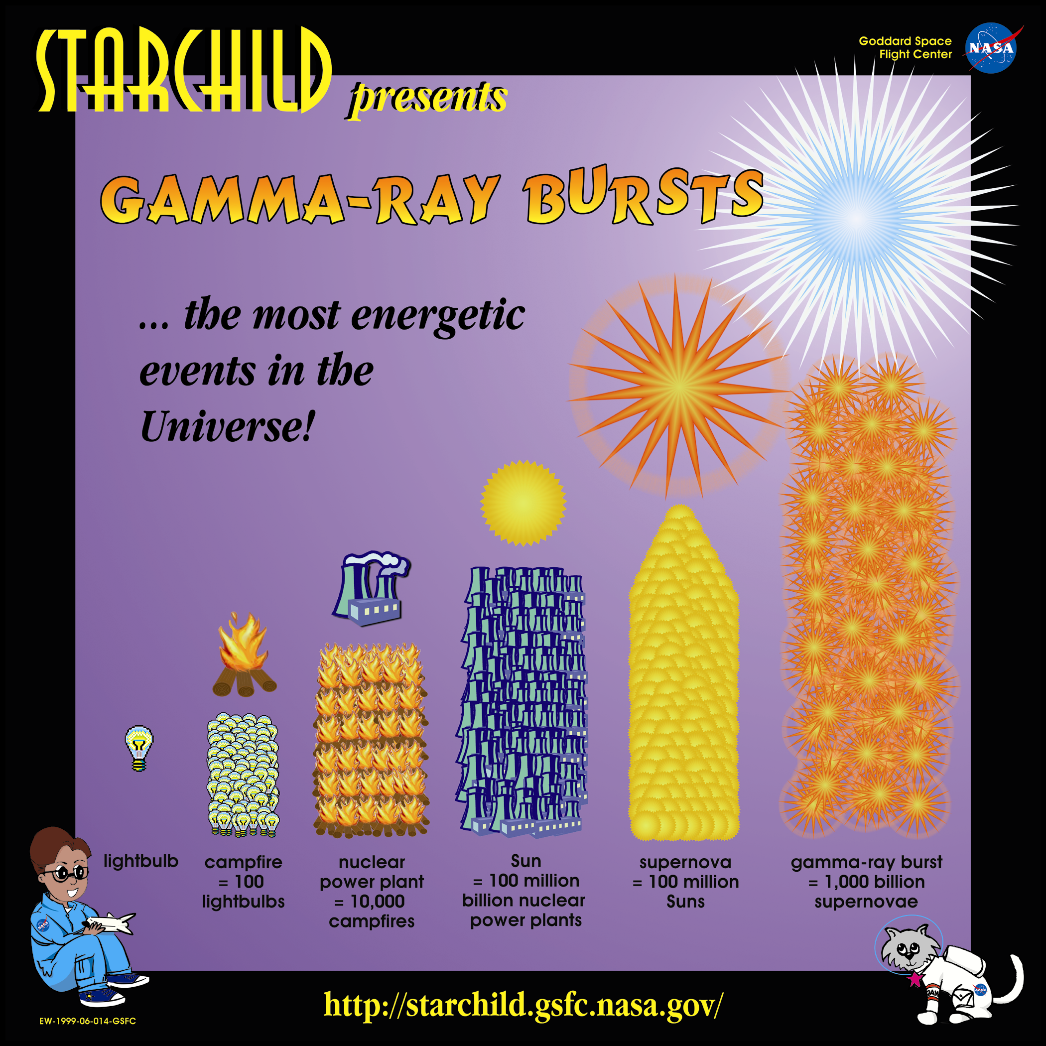
Reaching Teachers
StarChild and Imagine! GRB Posters and Activity Booklets
15000 of each printed
CSTA 10/99: 1000 distributed
NSTA 4/00: ~20,000 teachers
NCTM 4/00: ~18,000 teachers
presented to ~100 teachers at CSTA
workshops also at NSTA and NCTM

Slide 10

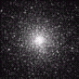
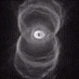
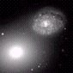
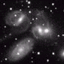
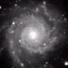
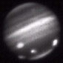
Appalachian Region Pilot Project
http://www.outreach.psu.edu/PSIWA/
Bring Excitement to Your Classroom!
No field of physical science has influenced young people’s imaginations more than astronomy. New discoveries have stimulated a resurgence in astronomy education in universities, and most recently at the secondary level. Students’ understanding of the structure and laws governing the physical universe are nourished within studies of new planets, exploding stars, swirling galaxies, the expanding universe, and the possibility of alien life. The Penn State Department of Astronomy & Astrophysics is offering two one-week workshops for teachers and two one-week camps for students entering grades 8–10 …..

Slide 11



http://www.outreach.psu.edu/EdComm/WITNweb/
WHAT'S IN THE NEWS? is an award-winning multi-media instructional series that uses current events as a springboard for exploring history, geography, government, world cultures, science, language arts, and all other areas of the curriculum.
Utilized in 4th-to-7th grade classrooms around the country, WHAT'S IN THE NEWS? is a comprehensive and challenging instructional tool that combines 15-minute television programs with computer-based resources and print materials.
For Kids Only!
Teacher Materials

Slide 12

NASA QuestChats
http://quest.arc.nasa.gov/ltc/
Students will experience the excitement and inspiration accrued from interacting live with someone who works for NASA!
A QuestChat is an opportunity for students and the general public to meet and ask questions of NASA experts using the Internet. From their own desktop, people can type comments and questions into a "chat room" and receive live responses from NASA personnel.

Slide 13
E/PO Dissemination Plan
Educator workshops and exhibits at NSTA, NCTM, CSTA, NTTI, etc.
Swift E/PO Web site
NASA OSS Forums and Broker/Facilitators
NASA CORE
NASA Science/Education Gateway
NASA Quest Web site
Videodiscovery Web site, marketing, and catalog
GEMS Web site, marketing, and catalog
Dissemination measured by professional evaluators

